Slide 1

Online Book Reselling
→Batch 1 Group 4
This Photo by Unknown Author is licensed under CC BY

Slide 2
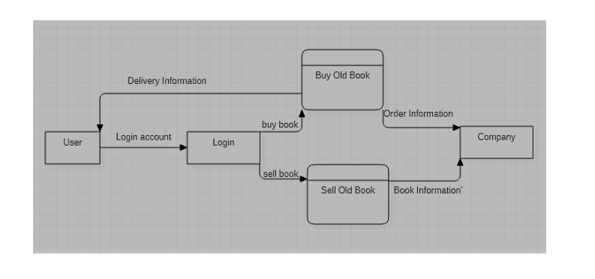

Slide 3
Modules:
Modules:
User:
Registration: User need to register first with their basic registration details and nee to create a valid login id and password.
Login: Using valid login credentials, user need to login into the system in order to access the system.
View Books: Once user is logged into the, he/she may view all the added books with their details.

Slide 4
Buy Books: User can surf various book of their choice and buy them.
Add Books: System allows user to sell their books online buy added the book name and its details.
Upload Books: User need to upload a book if he/she wants to sell a book.

Slide 5
My Orders: All the purchase history of user will be displayed with details.
View Buyer: If any buyer is interested in buying a book or anyone buys a book from the user then buyer’s details will be displayed.

Slide 6
Admin:
Login: Using valid login credentials, admin need to login into the system in order to access the system.
View Books: Admin can view all the added books online with their details.
View Transaction: System allows admin to view all the transaction details of buying and selling a book.
View User: All the registered user details will be displayed to the admin

Slide 7
Softwares used :-
Java Eclipse
Sql
Angular
Springboot

Slide 8
Workplan:-
Frontend – Hima Bindu, Indira
Backend – Ushasri, Haritha
Database- Bhargavi
Testing –Hymavathi

